Slide 1
Computer Networking
SMTP PROTOCOL: RESEARCH PAPER PRESENTATION

Slide 2

Group 9
KANISHKA SONI | — | N045
VAIBHAV SONI | — | N046
SNEHIL SUMAN | — | N047
VAISHNAVI SUROTH | — | N048
TARUN TANMAY | — | N049

Slide 3

A BRIEF OVERview of algorithms

Slide 4

DNS
Domain Name System

Slide 5
WHAT IS DNS?
01
DEFINITION
02
Access Information
03
Browser Interaction
04
Translation
The Domain Name System (DNS) is the phonebook of the Internet.
Humans access information online through domain names, like nytimes.com or espn.com
Web browsers interact through Internet Protocol (IP) addresses
DNS translates domain names to IP addresses so browsers can load Internet resources.

Slide 6
CONCLUSIONS
PROCESS
ASSINGING ip
The process of DNS resolution involves converting a hostname (such as www.example.com) into a computer-friendly IP address (such as 192.168.1.1).
An IP address is given to each device on the Internet, and that address is necessary to find the appropriate Internet device - like a street address is used to find a particular home

Slide 7
AUTHORITATIVE VS RECURSIVE DNS SERVERS
Recursive Servers
Authoritative Servers
Recursive servers are the workhorses in the DNS lookup process. They often have to make numerous DNS lookups in order to respond with the proper IP for the querying client. These kinds of servers are typically managed by an ISP or specialty resolving DNS providers.
For example, Google runs their own public recursive DNS servers.
If you own a domain name, at some point you will need to use an Authoritative DNS server to map your domain names to an IP address. This is only done on an Authoritative DNS server

Slide 8
Steps in a DNS lookup
A user types ‘example.com’ into a web browser and the query travels into the Internet and is received by a DNS recursive resolver.
The resolver then queries a DNS root nameserver.
The root server then responds to the resolver with the address of a Top-Level Domain (TLD) DNS server (such as .com or .net), which stores the information for its domains.
When searching for example.com, our request is pointed toward the .com TLD.
The resolver then makes a request to the .com TLD.

Slide 9
Steps in a DNS lookup
6. The TLD server then responds with the IP address of the domain’s nameserver, example.com.
7. Lastly, the recursive resolver sends a query to the domain’s nameserver.
8. The IP address for example.com is then returned to the resolver from the nameserver.
9. The DNS resolver then responds to the web browser with IP address of the domain requested initially.

Slide 10
DNS CACHING
To get around this problem, DNS information is shared among many servers. But information for sites visited recently is also cached locally on client computers. Additional caching can occur on the routers used to connect clients to the internet, as well as on the servers of the user’s Internet Service Provider.

Slide 11

HTTP
Hypertext transfer protocol

Slide 12
What is HTTP?
It is the set of rules for transferring files, such as text, graphic images, sound, video, and other multimedia files, on the World Wide Web.
It is an application protocol that runs on top of the TCP/IP.
It was invented alongside HTML to create the first interactive, text-based web browser: the original World Wide Web. Today, the protocol remains one of the primary means of using the Internet.
This protocol is known as Hyper-Text Transfer Protocol because of its efficiency that allows us to use in a hypertext environment where there are rapid jumps from one document to another document.

Slide 13
Features of HTTP
Connectionless protocol: HTTP is a connectionless protocol. HTTP client initiates a request and waits for a response from the server. When the server receives the request, the server processes the request and sends back the response to the HTTP client after which the client disconnects the connection. The connection between client and server exist only during the current request and response time only.
Media independent: HTTP protocol is a media independent as data can be sent as long as both the client and server know how to handle the data content. It is required for both the client and server to specify the content type in MIME-type header.
Stateless: HTTP is a stateless protocol as both the client and server know each other only during the current request. Due to this nature of the protocol, both the client and server do not retain the information between various requests of the web pages.

Slide 14
How does HTTP work?
Communication between client computers and web servers is done by sending HTTP Requests and receiving HTTP Responses. Clients are often browsers (Chrome, Edge, Safari), but they can be any type of program or device. Servers are most often computers in the cloud.
HTTP REQUEST/RESPONSE:-
Communication between clients and servers is done by requests and responses:
A client (a browser) sends an HTTP request to the web.
A web server receives the request.
The server runs an application to process the request.
The server returns an HTTP response (output) to the browser. The client (the browser) receives the response.

Slide 15


smtp
SIMPLE
PROTOCOL

Slide 16

smtp
it
is
everywhere.

Slide 17
SENDER
RECEIVER
INTERNET
SMTP
POP3
SMTP
Server
POP3
Server
SMTP
SMTP

Slide 18


a
b
c
SIMPLE
FONTS

Slide 19

A LITTLE HELP
MIME
SMTP

Slide 20
STOP!
Your Quota Ends Here

Slide 21

POP3
POST-OFFICE
PROTOCOL

Slide 22
SENDER
RECEIVER
INTERNET
SMTP
POP3
SMTP
Server
POP3
Server
SMTP
SMTP

Slide 23
ERRORS?
Minimal

Slide 24



a
b
c
Disadvantages

Slide 25

FTP
FILE TRANSFER PROTOCOL

Slide 26
What IS FTP?
Network Protocol
ARCHITECTURE
DATA AND CONNECTIONS
FILE SHARING
SECURITY
It is network protocol
Client-Server Architecture
Data and Control Connections are separated
File sharing over TCP/IP protocol
Security to protect data

Slide 27
FEATURES OF FTP
Data Representation
Transmission Modes
Access Control
Error Control
File Organization and Data Structures

Slide 28
HOW DOES FTP WORK ?
Users provide credentials to FTP server
Command channel initiates instruction and response
Data channel where data is distributed
Active Connection: Server grants access but firewall blocks connection
Passive Mode: User establishes command and data channel, server listens

Slide 29
Review paper protocol Snmp

Slide 30

SNMP introduction
Agents, Managers, Protocols and PDUs

Slide 31
SIMPLE NETWORK MANAGEMENT PROTOCOL
It has a particular role in network management. It defines the format of the packet which is sent by the manager to the agent and vice versa. It also interprets the result and creates statistics. SNMP defines the structure of packet exchanges between a manager and an agent. It reads and changes the status of objects (values of variables) in SNMP packets.
It is an application that allows:
A manager to retrieve the value of an object defined in an agent.
A manager to store a value in an object defined in an agent.
An agent to send an alarm message about an abnormal situation to the manager.
SNMP works by sending messages, called protocol data units (PDUs), to devices within the neighbouring network that "speak" SNMP.

Slide 32
SNMP MANAGER
A manager is a host that runs the SNMP client program. It hosts and monitors agents.
The manager can access all the values in a database, and it can fetch and compare the costs of variables from a router that it connects.
A manager can also make the agent perform a certain number of actions.
A SNMP Manager's essential functions involve querying agents, getting responses from agents, acknowledging asynchronous events from and setting variables in agents.

Slide 33
SNMP Agent
The agent is a program that is packaged within the network element
Enabling the agent allows it to collect the management information database from the device locally and makes it available to the SNMP manager
SNMP agent’s key functions
Collects management information about its local environment
Stores and retrieves management information
Signals an event to the manager
Acts as a proxy for some non–SNMP manageable network node

Slide 34
SNMP MANAGEMENT
a
b
c
A manager checks an agent by requesting information that reflects the behaviour of the agent.
A manager forces an agent to perform a task by resetting values in the agent database.
An agent contributes to the management process by warning the manager of an unusual situation.

Slide 35
Protocols of SNMP
Smi
MIB
To name objects
Defining the type of data which can be stored in an item
To show how to encode data for transmission over the network.
MIB creates a collection of named objects, types, and their relationships to each other in a manageable entity.
Each agent has its own MIB, which is a collection of all the items a manager can handle

Slide 36
SNMP Protocol Data Units PDUS
GetRequest
GetNextRequest
GetBulkRequest
Response
Trap
InformRequest
SetRequest
Report

Slide 37

SNMP Versions and Security

Slide 38
SNMP V3 > SNMP V2
Expanded data types
Confirmed event notifications
Improved efficiency and performance
Richer error handling
Fine tuned data definition language
64-bit counters
Inform operator
Get-bulk operator
Errors and exceptions
SMI, textual conventions

Slide 39
Security Threats
01
Masquerade
02
Modification of Information
03
Message Stream Modification
04
Disclosure
05
Unauthorized Access

Slide 40

SNMP CONFIGURATION

Slide 41
Overview
The SNMP Service, when configured for an agent, generates trap messages that are sent to a trap destination, if any specific events occur.
For example, you can configure the SNMP service to send a trap when it receives a request for information that does not contain the correct community name and does not match an accepted host name for the service.

Slide 42
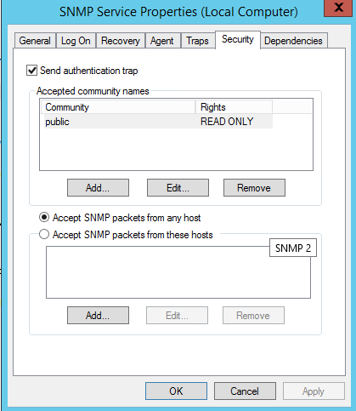
CONFIGURING SNMP agent IN WINDOWS XP
Click Start, point to Settings, click Control Panel.
Under Administrative Tools, click Services.
In the details pane, right-click SNMP Service and select Properties.
In the Security tab, select Send authentication trap if you want a trap message to be sent whenever authentication fails.
Under Accepted community names, click Add.
Under Community Rights, select a permission level for this host to process SNMP requests from the selected community.
In Community Name, type a case-sensitive community name, and then click Add.
Specify whether or not to accept SNMP packets from a host:
To accept SNMP requests from any host on the network, regardless of identity, click Accept SNMP packets from any host.
To limit acceptance of SNMP packets, click Accept SNMP packets from these hosts, click Add, type the appropriate host name, IP or IPX address, and then click Add again.
Click Apply to apply the changes.

Slide 43
Configuring SNMP traps
Click Start, point to Settings, click Control Panel.
Under Administrative Tools, click Services.
In the details pane, right-click SNMP Service and select Properties.
In the Traps tab, under Community name, type the case-sensitive community name to which this computer will send trap messages, and then click Add to list.
Under Trap destinations, click Add.
In the Host name, IP or IPX address field, type host name or its IP address of the server to send the trap and click Add.
Repeat steps 5 through 7 until you have added all the communities and trap destinations you want.
Click OK to apply the changes

Slide 44

Types of monitoring tools

Slide 45
Overview
Monitoring of network performance is required for the following reasons:
To automatically discover, monitor, and manage SNMP network devices.
To view the network performance and hence identify any strategic issues which may arise (such as points of unreliability, Quality of service, Bottlenecks etc).
It also provides the data in an intuitive formats like dashboards and graphs.
Monitoring Tools are broadly classified according to the following parameters:
Active/Passive
Network Layer Used
Basic Operation

Slide 46
Integrated SNMP Monitoring Platforms
The integrated SNMP network management system platform analyses the data by actively collects network information from network devices.
It leverages SNMP to give a complete view of a network.
Integrated SNMP network management systems provide alerts based on real-time monitoring and reporting and any of the monitored performance characteristics.
Most integrated platforms provide graphic reporting, administration of networks and monitoring id.
The typical performance characteristics are bandwidth utilization, response time, throughput, error rates, CPU load and memory utilization of network equipment and servers.

Slide 47
Passive Analysis
Passive network analyzer merely listens to traffic that is on the network. They do not generate any traffic themselves while collecting data.
They are also known as packet capture tools or packet sniffers.
As they will only see the traffic which is local to the device running the analyzer, the breadth of the analysis generated by passive tools is fundamentally limited.
E.g.:- A passive system would only see traffic sent to or from its host in a switched Ethernet environment.

Slide 48
Application and Service Monitoring
The Application and Service monitoring tools, keep track of crucial systems necessary to keep the network up, healthy and running.
This tool notifies the authorized personnel and network administrators, so the problem gets fixed long before it takes out the entire system.
This type of monitoring tool depends less on the network equipment and infrastructure and more on the actual servers that provide user services.
One everyday use for application monitoring is Website availability monitoring.
Database monitoring consists of Server load, memory and disk usage, transaction rate, and concurrent connection count. Administrators can use this information to quickly identify and resolve application problems and evaluate infrastructure performance for bottlenecks or excess capacity.

Slide 49
Flow Monitoring
Instead of looking at the traffic from a packet level, flow monitoring analyses the network traffic as flows.
Flow monitoring aggregates the network based on individual connections, protocols, users, or applications.
It allows them to provide a bigger picture view of the network, which includes specific information on connection performance and Application and insight into routing and even network security.
As flow monitoring can identify traffic trends, It also aids in traffic engineering and network planning.

Slide 50
MONITORING TOOLS: OVERVIEW
Type of monitoring tool | Passive/ Active | Network layer used | Basic Operation
Passive Analysis | Passive | Data link layer | Analyzes by listening for and capturing packets on a network device
Application and service monitoring | Active | Application layer | To provide performance information, actively polls applications and applications servers.
Integrated SNMP Monitoring Platforms | Active | Data link and network layer | To gather information about the network, a management station polls agents on network devices.
Flow Monitoring | Active | Transport and higher layer | For higher layer trends, monitors connections and flows on the network.

Slide 51

SNMP Implementation
MONITORING TOOLS

Slide 52
Overview
Simple Network Management Protocol is implemented using monitoring tools to manage several devices connected to a network.
SNMP monitoring tools support this feature by providing security.
To manage devices, SNMP equips network administrators to access, collect, organize and modify data and information about a device's behaviour.
The SNMP monitoring tools allow receiving and configuration alerts, monitoring device performance metrics, undertaking active polling and offering granularity, accuracy, and efficiency to determine network health and performance.

Slide 53



Monitoring tools
Comprehensive SNMP tool, compatible with Windows and Linux
Provide Higher level security with multi-level thresholding
features such as network mapping, status monitoring, traffic analysis, and utility utilities. customizable on its dashboard
Security breaches warning
Best monitoring tool for the Windows Platform
It is agentless and integrates with Kaseya VSA.
The range of monitoring services it offers, such as log, SNMP trap, file and directory, and mail QoS monitoring,
can be used to establish an ideal network management system.
Compatible with Windows, MacOS, and Linux
Run commands directly in the terminal and perform actions such as restarting services, applying updates
Users manage transactions from their mobile devices.
Alert systems that currently do not offer any customization to receive notifications

Slide 54


Monitoring tools
The customization feature is what gives Spiceworks a serious advantage over other free SNMP managers on the market
However, if they need a sophisticated SNMP monitoring system for a large network, they would probably be better off with a more advanced and paid tool
Whatsup Gold is an excellent tracking system by the Ipswich brand
It can display current status information for use on another system and automatically switch network devices to maintenance mode before applying any permanent changes
The Logic Monitor tool combines the functionality of SNMP with data from NetFlow and provides a comprehensive view of network performance
The tool relies on a cloud-based system and uses the software as a service approach that allows users to access and monitor devices from offsite located servers

Slide 55
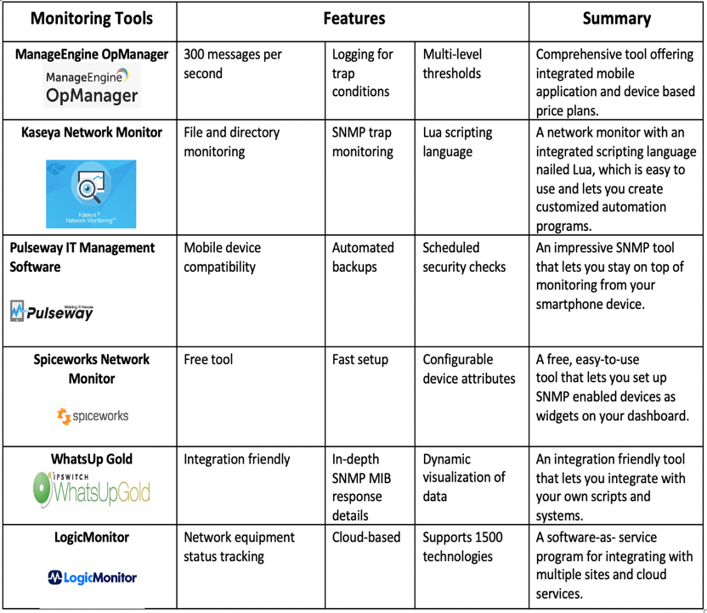
Features and applications

Slide 56
conclusion

Slide 57

THANK you
Please keep this slide for attribution.

